Slide 1
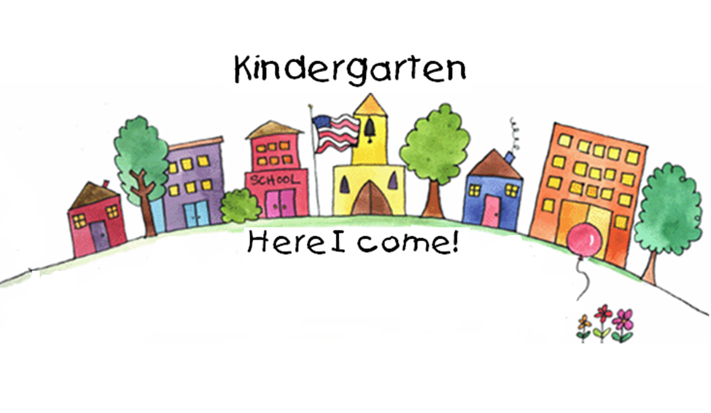
Brubaker Elementary
Kindergarten Orientation

Slide 2
Orientation Schedule
Meet the staff and teachers
Nursing information
Arrival and dismissal
Metro Kids
Conferences
Early Out Wednesdays
School Lunch
Use district website for information
Kindergarten Expectations
PBIS Expectations
PTA
Volunteers

Slide 3
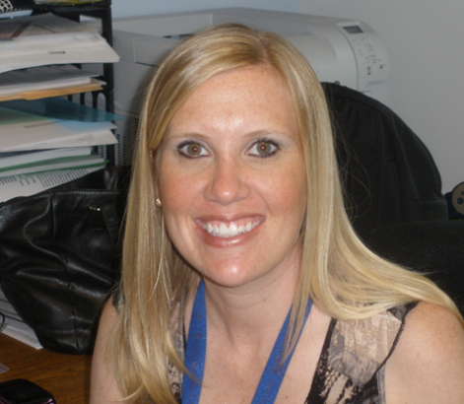
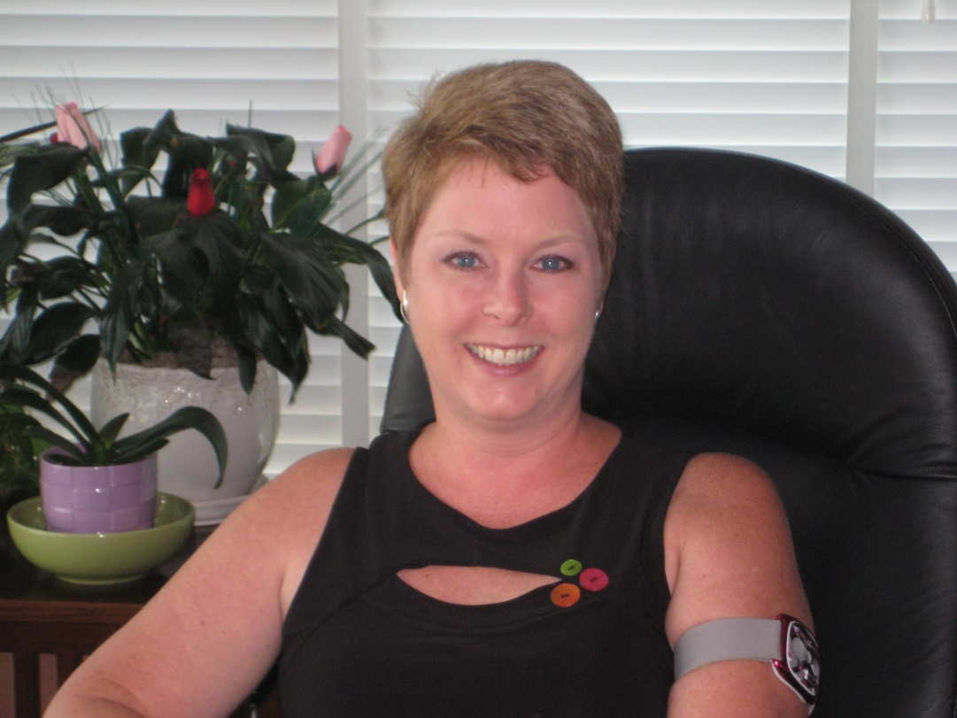
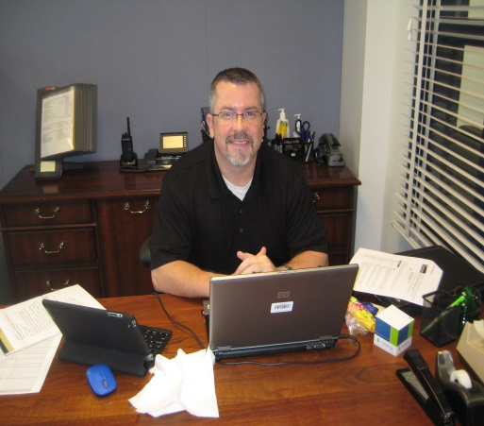
Administrative Staff
Renee Gelfond
Dean of Students
Amy Wiegmann
Principal
Mark Adams
Dean of Students

Slide 4
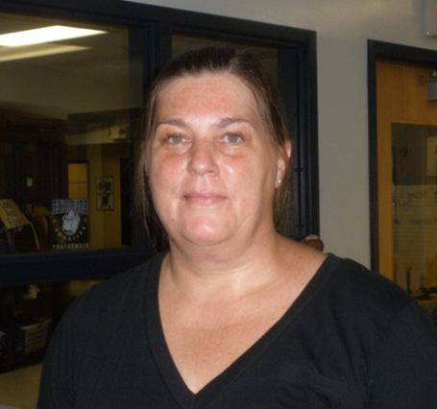
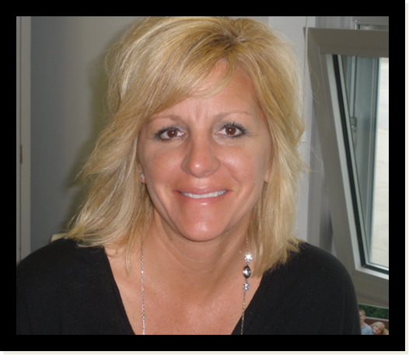
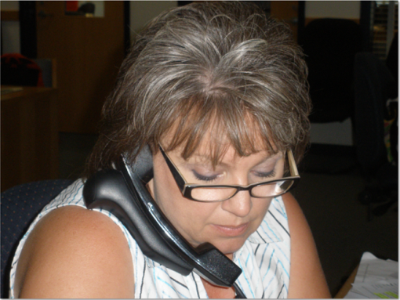
Office
Staff
Kathie Walker
Office Manager
Deb Smith
Office Clerk
Peggy Myers
Building Associate
Leeann Smoldt
Nurse

Slide 5
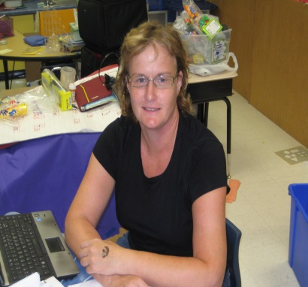
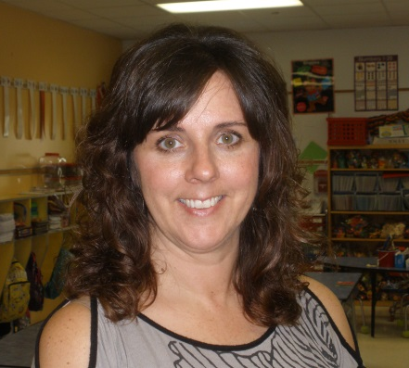
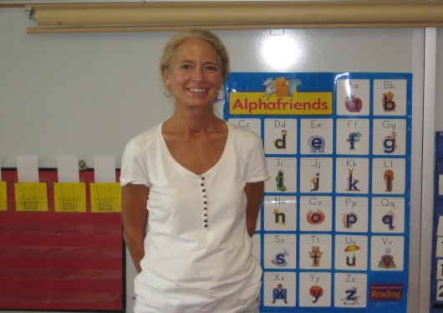
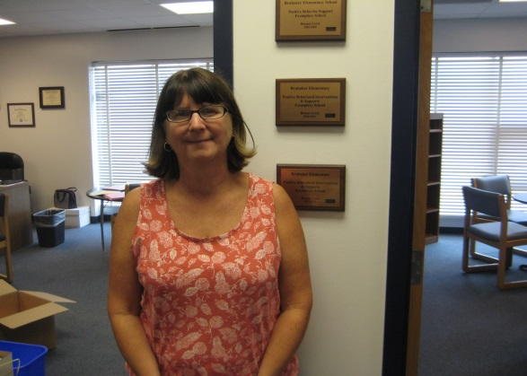
Brubaker Kindergarten Teachers
Tricia Negrete
Jennie Brehm
Jane Penisten
Kari Lamoreaux
Mary Beth West

Slide 6
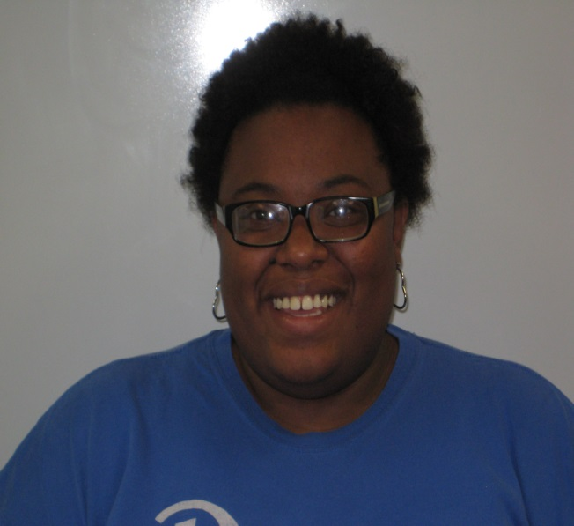
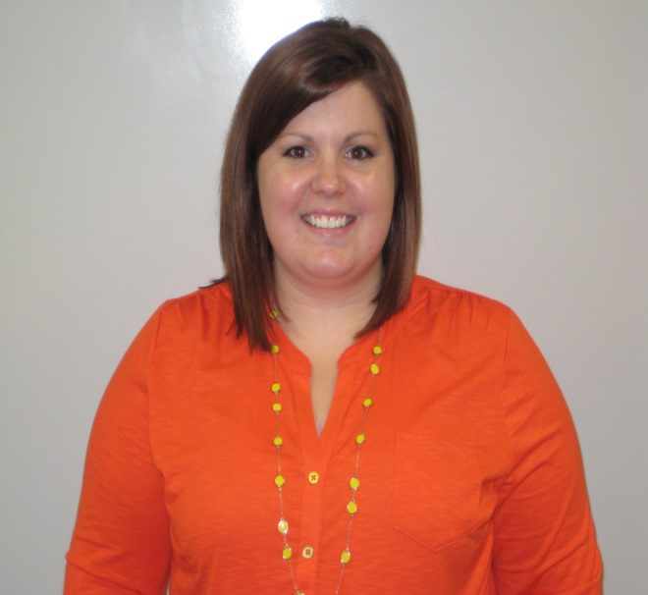
Kindergarten Support Teachers
Ashley Clark
Special Ed
Katie McCuddin
In-Class Support

Slide 7
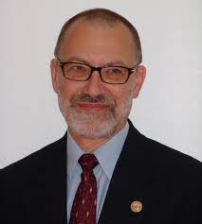
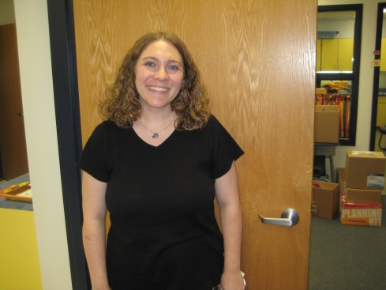
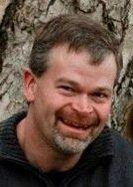
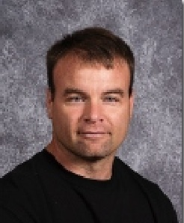
Music/Art/P.E.
Ken Esveld
Art
Laura Sampson
Music
Kathy Hermsen
P.E.
Jodi Fenton
Art
Scott Wiederstein
Music
Dwayne Bahe
P.E.

Slide 8
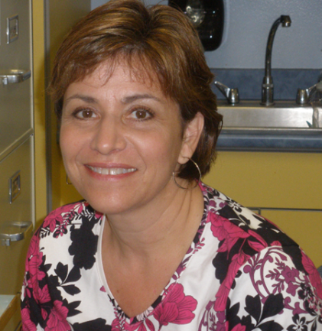
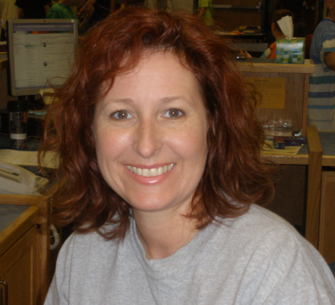
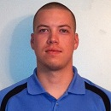
Counseling/Library
Barb Perkins
Guidance
Gia VanRoekel
Librarian
Brett Whittle
Guidance

Slide 9
Cafeteria Staff

Slide 10
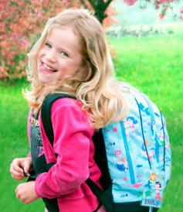
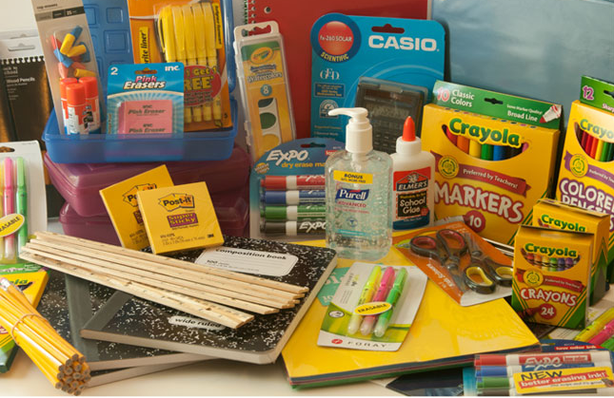
Come prepared to learn!
Basic school supplies are requested. Some items are community supplies. A list is available.
Backpacks are needed daily. Please avoid backpacks with wheels.

Slide 11
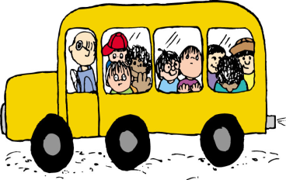
Arrival
Doors remained locked until 8:00 AM
8:00 AM – Breakfast begins
All students that enter at 8:00 will be
required to go eat breakfast in the
cafeteria where they will stay until the arrival bell rings.
8:25 AM – Students are dismissed from cafeteria
to their classrooms. All students enter building to begin the day.
8:35 AM – Final bell rings. Students must be in
their classrooms prior to final bell or
they need a late pass from office.

Slide 12
Dismissal
If you are picking your child up early, you must sign them out in the office.
3:20 PM – Kindergarten students leave the building
Exit from the North Door closest to the front of the building.
Walkers – picked up at North Door area
Auto Riders – picked up in “car line” at North Door area
Day Care Van – picked up in “car line” at North Door area
Bus Riders will line up in the gym and be escorted to their bus.
Early Out Wednesdays follow the same procedures at 1:50 PM.

Slide 13
Metro Kids enter through North Doors. A Metro staff will meet you at the door. All doors are locked prior to 8:00 AM.
Metro Kids is a fee-based before- and after-school child-care program available in elementary schools on school days. All kindergarten through fifth-grade students are eligible. Program hours are 6:30 a.m. to 5:45 p.m. On non-school days, all-day child-care services are available at regional sites.

Slide 14
Parent/Teacher Conferences
Fall Conferences – October 16, October 23
Spring Conferences – February 12, February 19
Early-out Wednesdays
Dismissal at 1:50 PM

Slide 15
“What did you learn today at school?”
“Hmmm…. I can’t remember!
Nothing!”

Slide 16
Reading

Slide 17
PBIS
Respectful
Responsible
Safe

Slide 18
Writing

Slide 19
Success

Slide 20
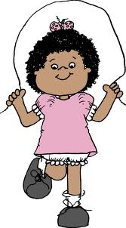
Exercises

Slide 21
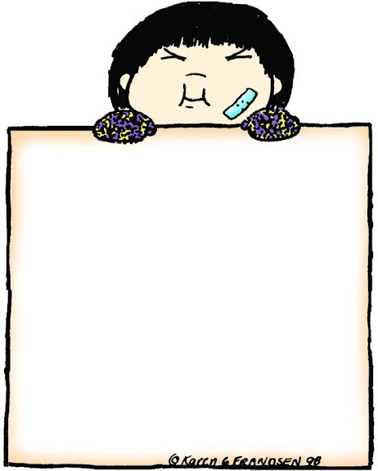
Health

Slide 22
Music

Slide 23
Science

Slide 24
Problem
Solving

Slide 25
History

Slide 26
Weather

Slide 27
Social
Skills

Slide 28
Lunch
Recess

Slide 29
Thinking

Slide 30
Art

Slide 31
Technology

Slide 32
Friends

Slide 33
Books

Slide 34
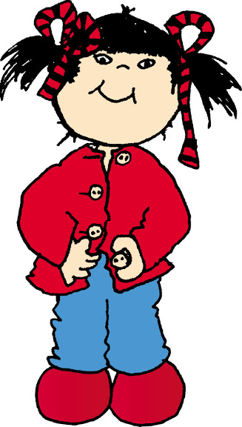
Self-help
Skills

Slide 35
Sharing

Slide 36
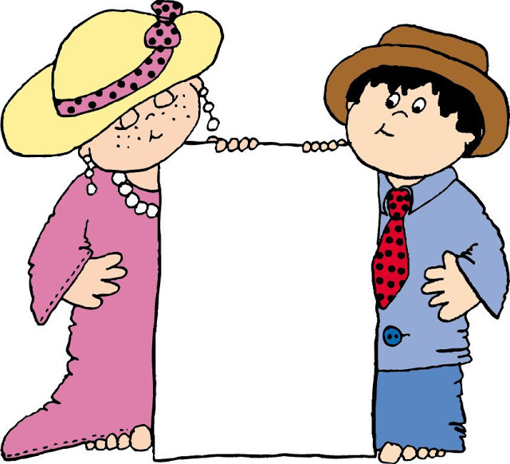
Real
and
Pretend

Slide 37
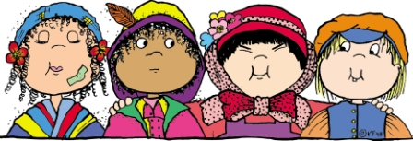
Diversity

Slide 38
Kindness

Slide 39
Pride

Slide 40
Family

Slide 41
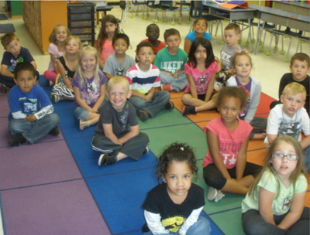
Kindergarten Expectations
Body Basics
Keep hands and feet to self
Walk in line
Sit at desk
Sit on carpet

Slide 42
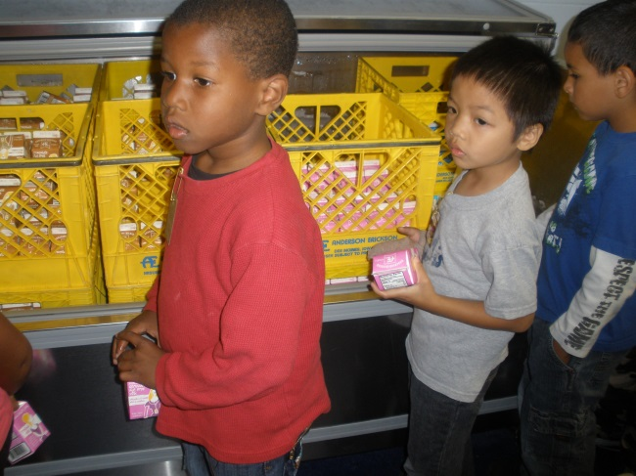
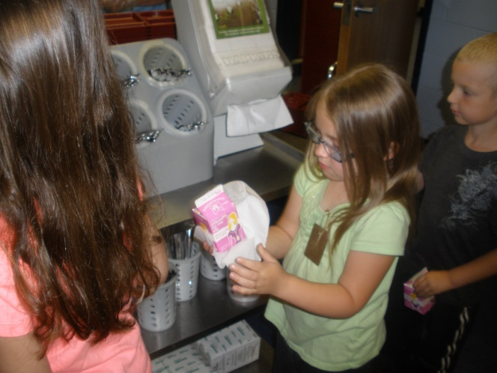
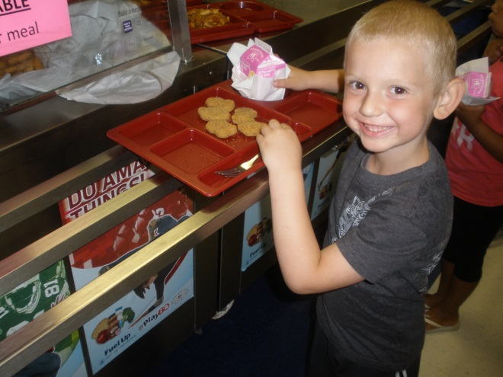
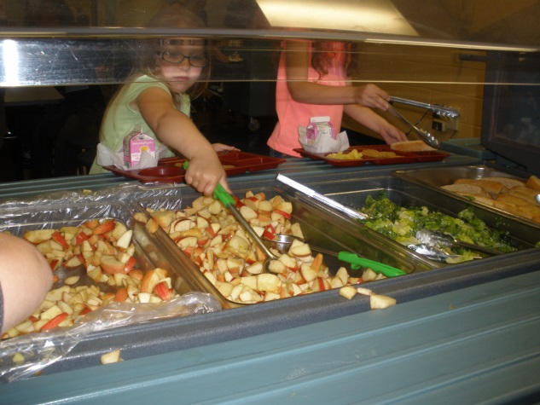
Lunch Routine
1. Choose milk
2. Get napkin
3. Get tray
4. Choose fruit/vegs

Slide 43
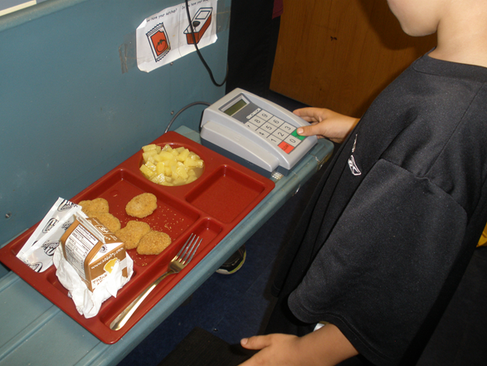
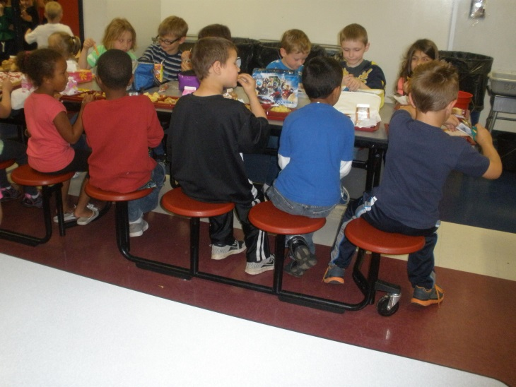
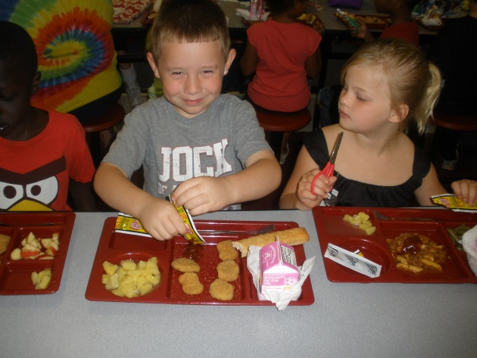
Student needs to memorize lunch ID
5. Enter lunch ID
7. Enjoy lunch!
6. Sit down

Slide 44
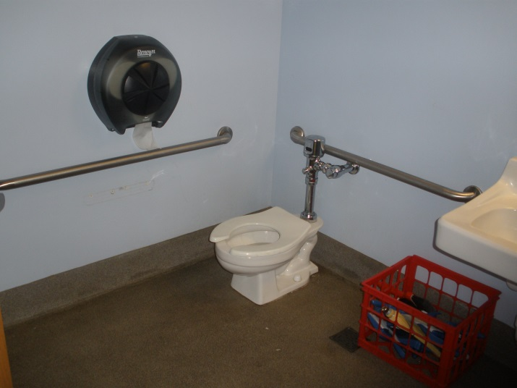
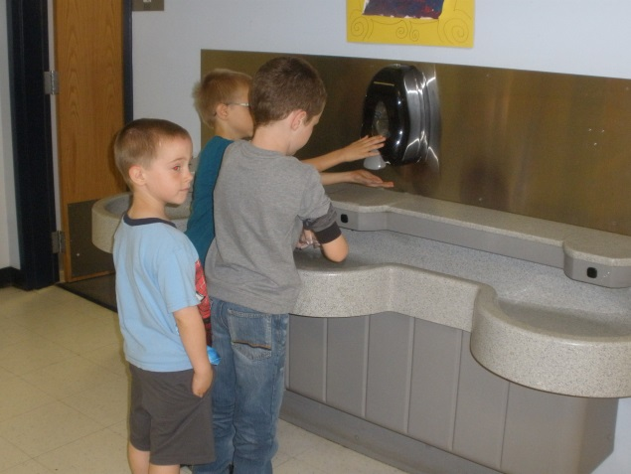
Bathroom Routines
Stay healthy by washing and drying hands!
Each classroom has its own bathroom. Students are encouraged to use the toilet independently.

Slide 45
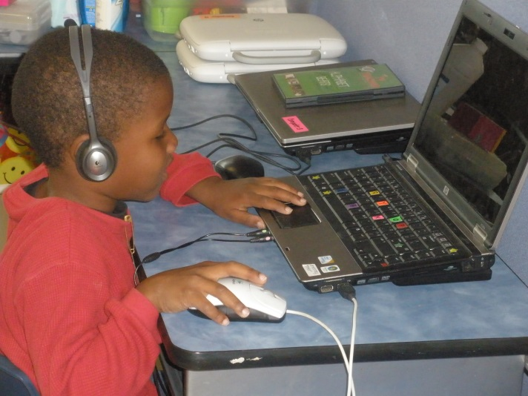
Library Routines
Students will visit the library once a week. They will be allowed to check out 1 book. Books MUST be returned the following week so that they can choose another book to read at home.
Students will use computers in the lab. Encourage them to practice navigating the mouse and key board. Passwords for educational sites will be sent home.

Slide 46
Healthy and Safe
Recess is a necessary part of a kindergartner’s day. Encourage your child to wear appropriate shoes and clothing.
Flip-flops should not be worn to school.
Weather permitting, we will have a recess everyday. Dress for the Iowa weather!

Slide 47
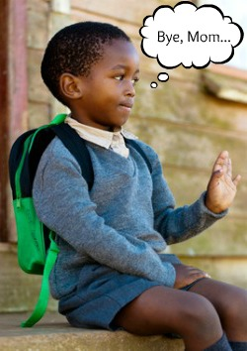
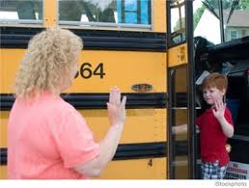
Encourage Independence
Thank you for sharing your child with us!

